Slide 1
Analysis of a website taken down
on claims of instigating violence
Harveen Kaur
Old Dominion University
CS-795 Web Archiving Forensics
hkaur001@odu.edu

Slide 2
In India, an average of 87 rape cases are reported daily
India is ranked as the most dangerous country for women
In 2019, 32,033 rape cases were registered in India
In 2019, Uttar Pradesh recorded a total of 59,835 cases of violence against women.
Conviction rate of rape cases: 27.8%
Specifically, dalit (untouchables) women in India face higher risk of gender and caste based violence
At least 10 Dalit women are raped every day
https://thewire.in/women/average-87-rape-cases-daily-over-7-rise-in-crimes-against-women-in-2019-ncrb-data
https://timesofindia.indiatimes.com/india/india-sees-88-rape-cases-a-day-but-conviction-rate-below-30/articleshow/78526440.cms
Harveen Kaur CS 795: Web Archiving Forensics (Fall 2020)

Slide 3
Police faces backlash from the public
It is difficult for a women to file a complaint in India, for Dalit (untouchable) women it is much harder.
Police are slow to register complaints
In the case of Dalit women investigations are delayed
Sometimes, police are involved in crime against Dalit (untouchable) women
https://www.dw.com/en/why-indias-dalit-women-are-vulnerable-to-sexual-violence/a-55423556
https://timesofindia.indiatimes.com/india/india-sees-88-rape-cases-a-day-but-conviction-rate-below-30/articleshow/78526440.cms
https://www.thenewsminute.com/article/opinion-how-caste-and-gender-are-intertwined-violence-against-dalit-women-135025
Harveen Kaur CS 795: Web Archiving Forensics (Fall 2020)

Slide 4
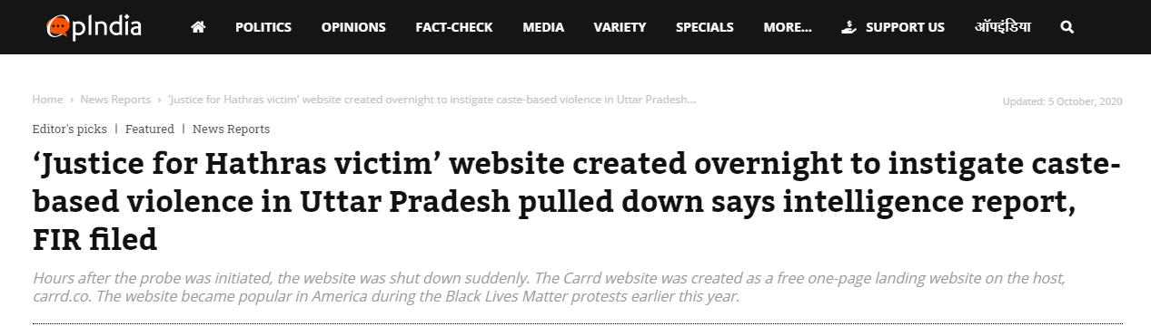
Website created for justice for Hathras rape victim was labelled to be instigating violence by the OpIndia
Right-wing news portal
Ruling party in Uttar Pradesh
Government in India is also right-wing
OpIndia article which claims the Carrd website instigated violence
https://web.archive.org/web/20201007042015/https://www.opindia.com/2020/10/justice-for-hathras-victim-carrd-website-pulled-down-instigate-violence-reports/
Harveen Kaur CS 795: Web Archiving Forensics (Fall 2020)

Slide 5
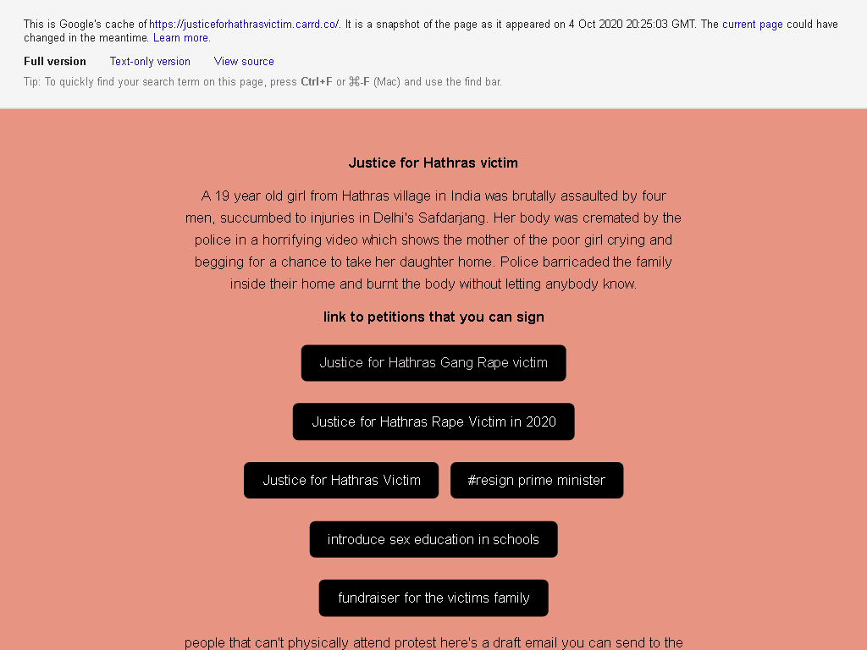
What was this website?
In October 2020,
https://justiceforhathrasvictim.carrd.co/ was taken down 5 days after it was created
The police claimed that the website instigated violence
Harveen Kaur CS 795: Web Archiving Forensics (Fall 2020)

Slide 6

What is Carrd?
Platform used to host one page responsive websites
Requirements to host a site are having an email address.
The creator is based in Tennessee, USA (Twitter: @ajlkn)
https://www.technologyreview.com/2020/08/27/1007714/carrd-internet-of-protest-is-being-built-on-one-shot-websites/#:~:text=Along%20with%20better%2Dknown%20tools,process%20of%20creating%20web%20pages.
https://carrd.co/
https://themakingof.carrd.co/
https://twitter.com/ajlkn
Harveen Kaur CS 795: Web Archiving Forensics (Fall 2020)

Slide 7

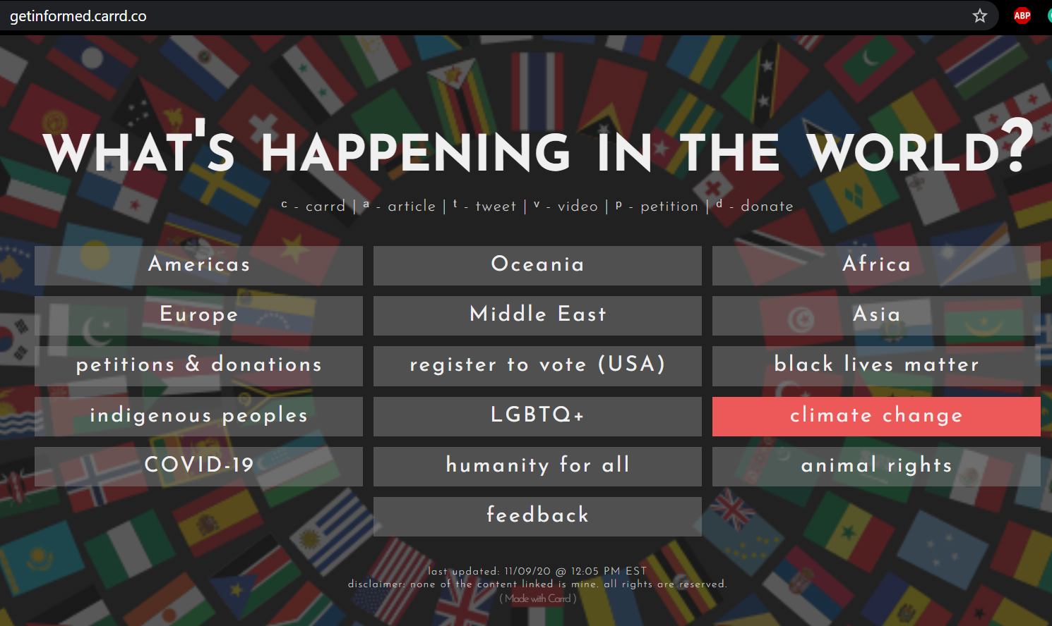
Internet Activism
These social justice related cards are being shared on social platforms like Twitter.
Carrd is being used for internet activism.
https://rb.gy/mbdema https://blacklivesmatters.carrd.co/
https://www.technologyreview.com/2020/08/27/1007714/carrd-internet-of-protest-is-being-built-on-one-shot-websites/#:~:text=Along%20with%20better%2Dknown%20tools,process%20of%20creating%20web%20pages.
Harveen Kaur CS 795: Web Archiving Forensics (Fall 2020)

Slide 8
Why was https://justiceforhathrasvictim.carrd.co/ created?
The website was created to hold protests against the recent gang rape and murder case in India.
On 14 September 2020, a 19 year old was raped in Hathras (Uttar Pradesh), India.
The victim passed away two weeks after the incident.
The victim was cremated on 29 September 2020 by the Uttar Pradesh Police (India) without the consent or knowledge of the victim's family.
https://www.shethepeople.tv/news/10-things-to-know-about-the-hathras-gang-rape-case/
https://en.wikipedia.org/wiki/2020_Hathras_gang_rape_and_murder
Harveen Kaur CS 795: Web Archiving Forensics (Fall 2020)

Slide 9
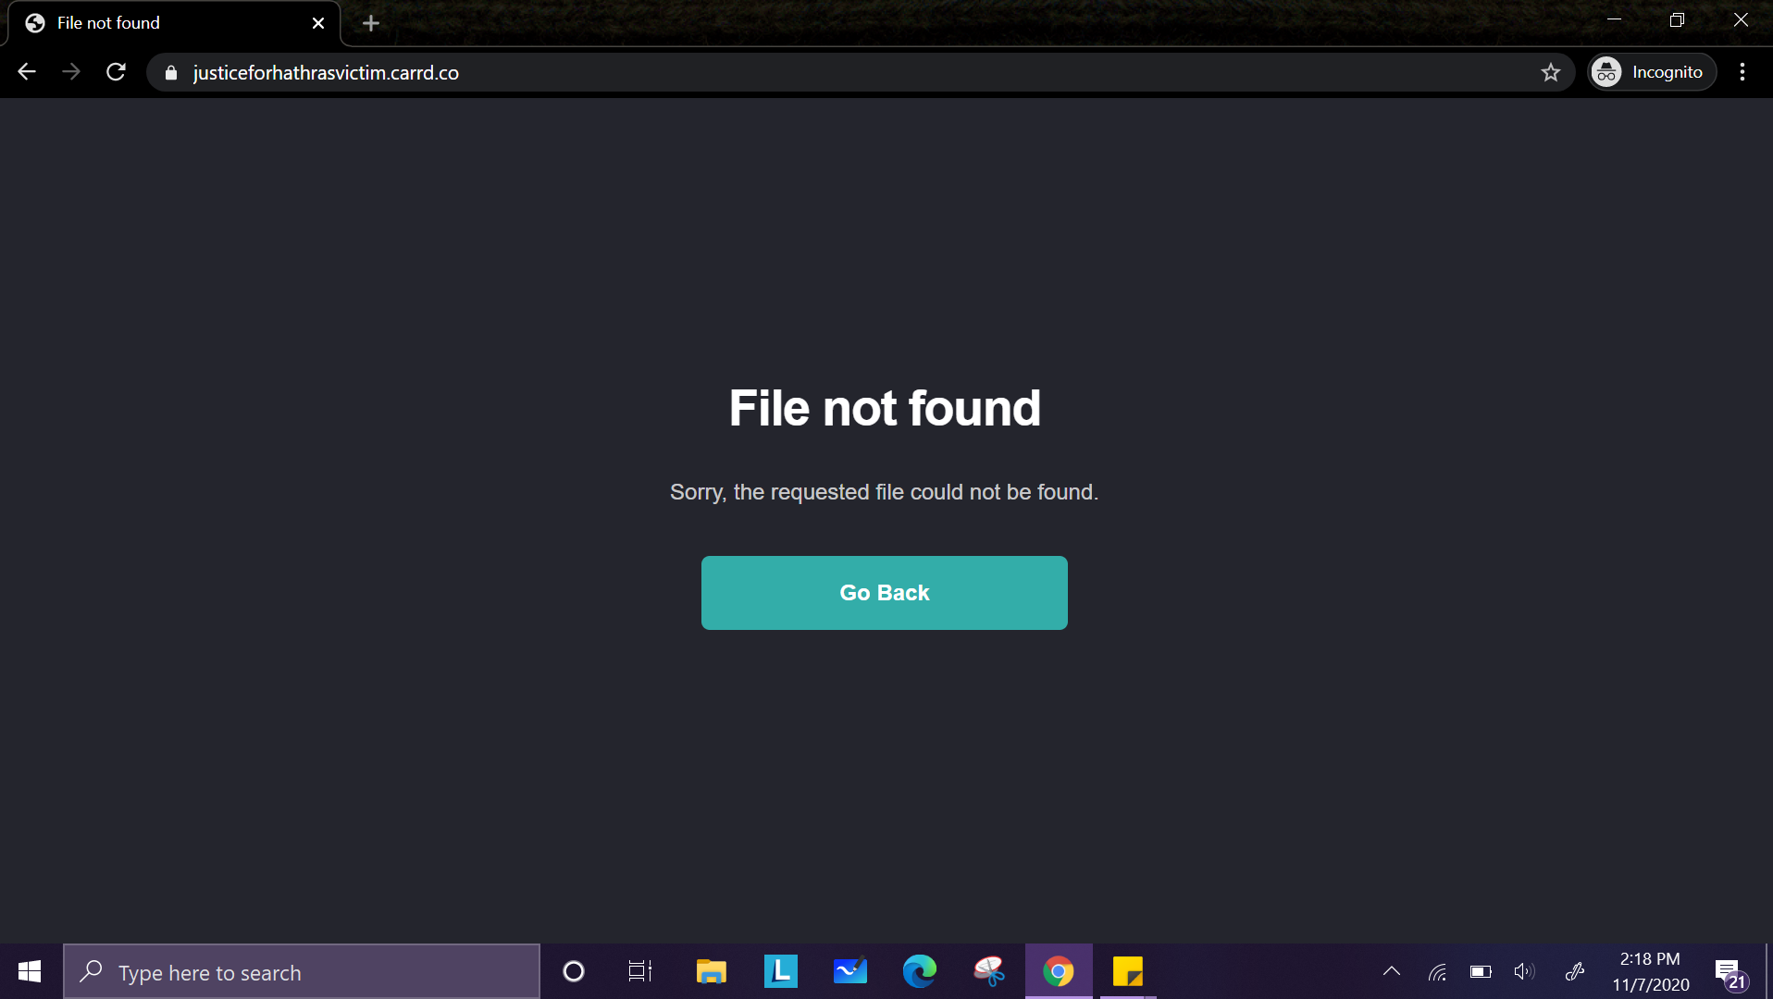
https://justiceforhathrasvictim.carrd.co
> curl -ILs https://justiceforhathrasvictim.carrd.co/ HTTP/2 404
date: Sat, 07 Nov 2020 19:21:09 GMT
content-type: text/html; charset=iso-8859-1
set-cookie: __cfduid=d7e5307f1384c0db1c6ce581f9c569cb21604776869; expires=Mon, 07-Dec-20 19:21:09 GMT; path=/; domain=.carrd.co; HttpOnly; SameSite=Lax
cf-cache-status: DYNAMIC
cf-request-id: 0645c0d52f0000cee0670e3000000001
expect-ct: max-age=604800, report-uri="https://report-uri.cloudflare.com/cdn-cgi/beacon/expect-ct"
set-cookie: __cflb=0H28unazevof7rv9ZiK1Lx6XDsNFxapSMcS2gLEE3bT; SameSite=Lax; path=/; expires=Sat, 07-Nov-20 19:51:09 GMT; HttpOnly
server: cloudflare
cf-ray: 5ee96a684ceacee0-IAD
Harveen Kaur CS 795: Web Archiving Forensics (Fall 2020)

Slide 10
16 mementos were found using memgator
> curl -s http://memgator.cs.odu.edu/timemap/link/https://justiceforhathrasvictim.carrd.co/ | grep datetime | awk '{print $1}' | awk -v FS=/ '{print $3}' | sort | uniq -c | sort -nr
14 web.archive.org
5 archive.md
> curl -s http://memgator.cs.odu.edu/timemap/link/https://justiceforhathrasvictim.carrd.co/ | grep memento | head -n 5
<http://archive.md/20201005065119/https://justiceforhathrasvictim.carrd.co/>; rel="first memento"; datetime="Mon, 05 Oct 2020 06:51:19 GMT",
<http://archive.md/20201006071445/https://justiceforhathrasvictim.carrd.co/>; rel="memento"; datetime="Tue, 06 Oct 2020 07:14:45 GMT",
<https://web.archive.org/web/20201006124530/https://justiceforhathrasvictim.carrd.co/>; rel="memento"; datetime="Tue, 06 Oct 2020 12:45:30 GMT",
<https://web.archive.org/web/20201006171352/https://justiceforhathrasvictim.carrd.co/>; rel="memento"; datetime="Tue, 06 Oct 2020 17:13:52 GMT",
<http://archive.md/20201007002801/https://justiceforhathrasvictim.carrd.co/>; rel="memento"; datetime="Wed, 07 Oct 2020 00:28:01 GMT",
Harveen Kaur CS 795: Web Archiving Forensics (Fall 2020)

Slide 11
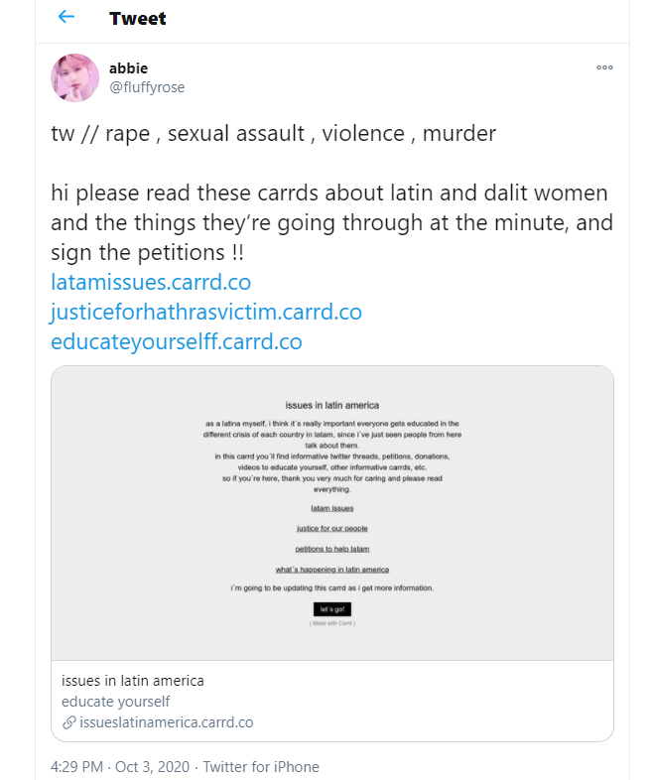
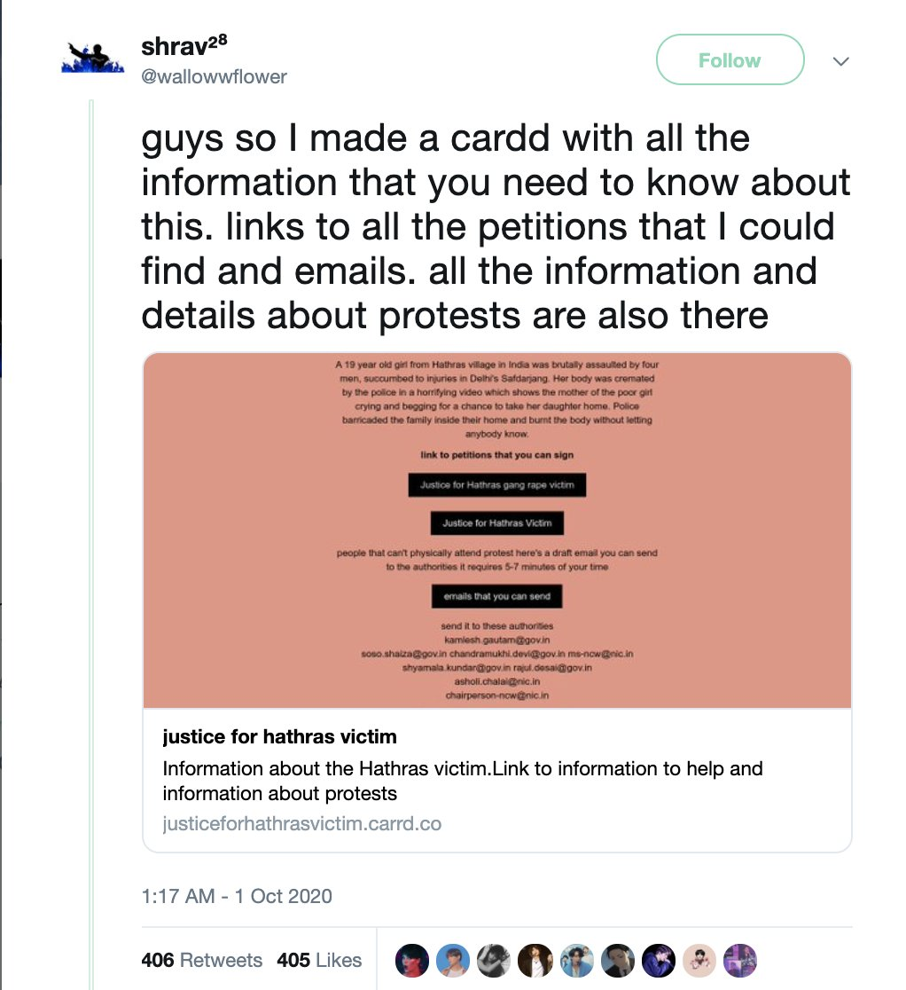
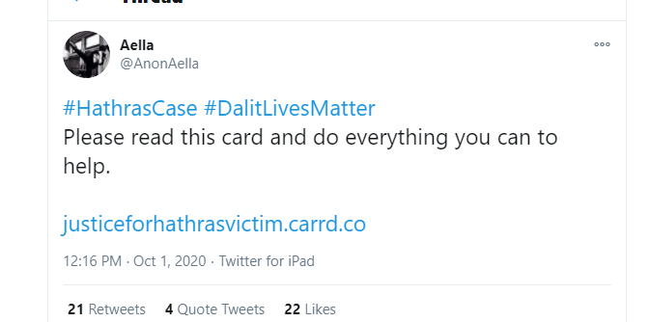
Estimated creation date of the Carrd website based on the tweets shared is October 1st, 2020
https://twitter.com/AnonAella/status/1311701479183482880
https://twitter.com/fIuffyrose/status/1312490035174809600https://twitter.com/Vedic_Revival/status/1312992239384236032
https://web.archive.org/web/20201007042015/https://www.opindia.com/2020/10/justice-for-hathras-victim-carrd-website-pulled-down-instigate-violence-reports/
Harveen Kaur CS 795: Web Archiving Forensics (Fall 2020)

Slide 12
The first memento is from 2020-10-05
Carbon dating the website
> carbondate https://justiceforhathrasvictim.carrd.co/
{
"self": "http://carbondate.cs.odu.edu/cd/https://justiceforhathrasvictim.carrd.co/",
"uri": "https://justiceforhathrasvictim.carrd.co/",
"estimated-creation-date": "2020-10-05T06:51:19",
"earliest-sources": [
"archive.md"
],
"sources": {
"archive.md": {
"uri-m": "http://archive.md/20201005065119/https://justiceforhathrasvictim.carrd.co/",
"memento-datetime": "2020-10-05T06:51:19",
"memento-pubdate": "2020-10-05T06:51:19",
"earliest": "2020-10-05T06:51:19"
},
"web.archive.org": {
"uri-m": "https://web.archive.org/web/20201006124530/https://justiceforhathrasvictim.carrd.co/",
"memento-datetime": "2020-10-06T12:45:30",
"memento-pubdate": "",
"earliest": "2020-10-06T12:45:30"
{
"self": "http://carbondate.cs.odu.edu/cd/https://justiceforhathrasvictim.carrd.co/",
"uri": "https://justiceforhathrasvictim.carrd.co/",
"estimated-creation-date": "2020-10-05T06:51:19",
"earliest-sources": [
"archive.md"
],
}
}
Estimated creation date: 2020-10-05.
Second memento: 2020-10-06
Harveen Kaur CS 795: Web Archiving Forensics (Fall 2020)

Slide 13
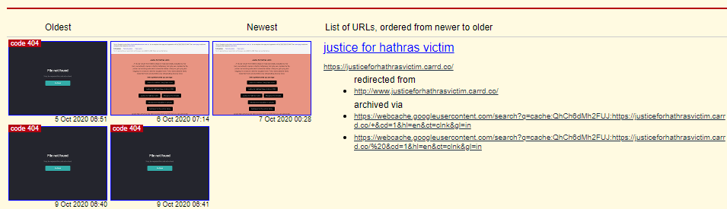
There are 5 mementos in archive.is
2 mementos show the actual website https://justiceforhathrasvictim.carrd.co/
Harveen Kaur CS 795: Web Archiving Forensics (Fall 2020)

Slide 14
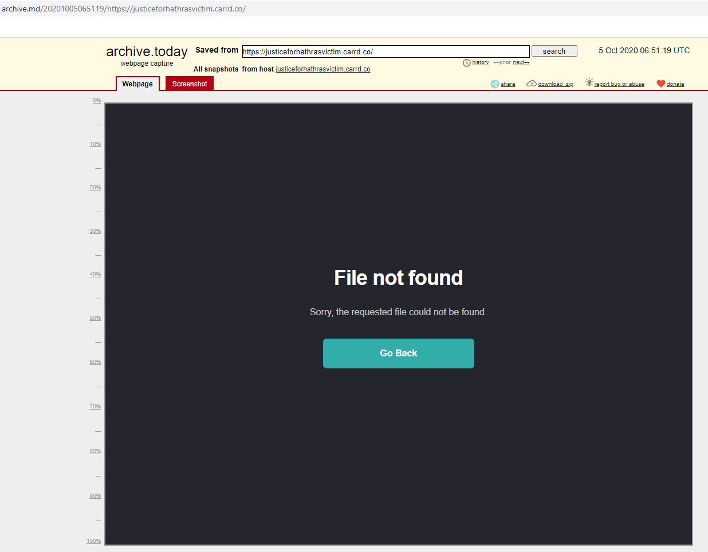
The first memento was created after the website was taken down
Website was down by: 2020-10-05
http://archive.is/https://webcache.googleusercontent.com/search?q=cache:QhCh6dMh2FUJ:https://justiceforhathrasvictim.carrd.co/+&cd=1&hl=en&ct=clnk&gl=in
Harveen Kaur CS 795: Web Archiving Forensics (Fall 2020)

Slide 15
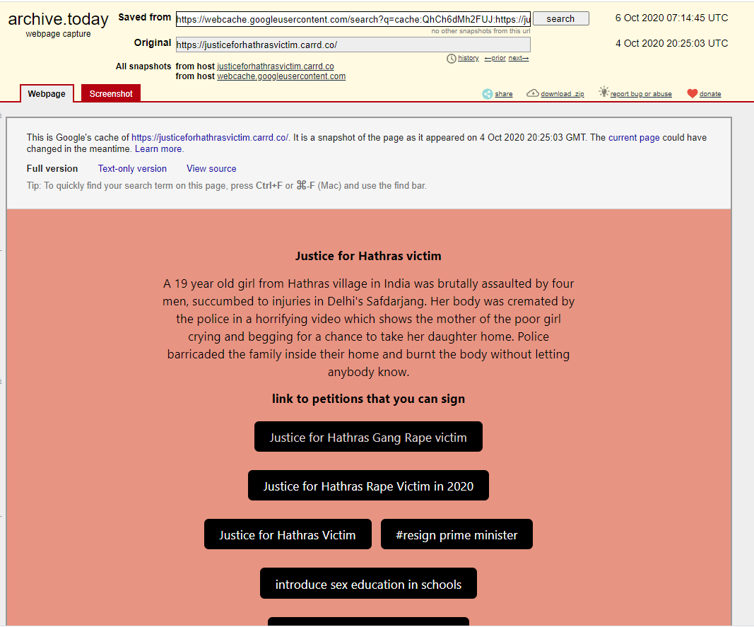
Memento of the website
Memento was created on 2020-10-06
The memento of the Google cache of the website as of 2020-10-04
http://archive.is/iAdP0
Harveen Kaur CS 795: Web Archiving Forensics (Fall 2020)

Slide 16
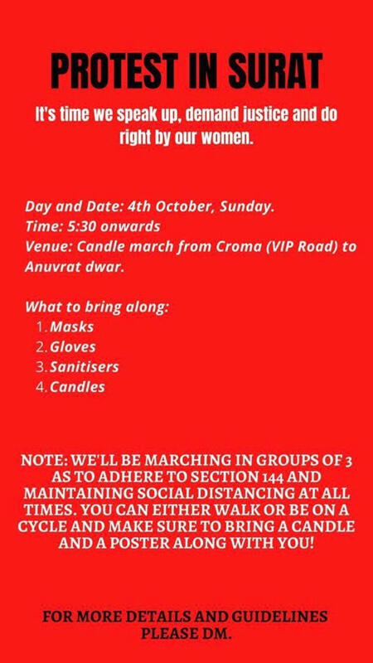

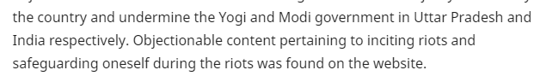

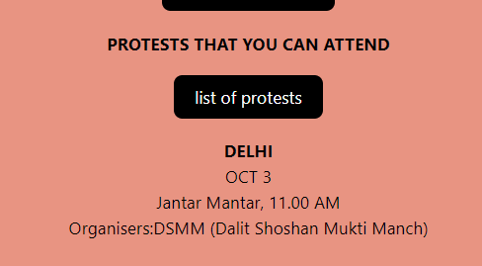
OpIndia article states the website incites riots
The article links to protests that were to be held all over India.
http://archive.is/iAdP0
https://web.archive.org/web/20201007042015/https://www.opindia.com/2020/10/justice-for-hathras-victim-carrd-website-pulled-down-instigate-violence-reports/
Harveen Kaur CS 795: Web Archiving Forensics (Fall 2020)

Slide 17
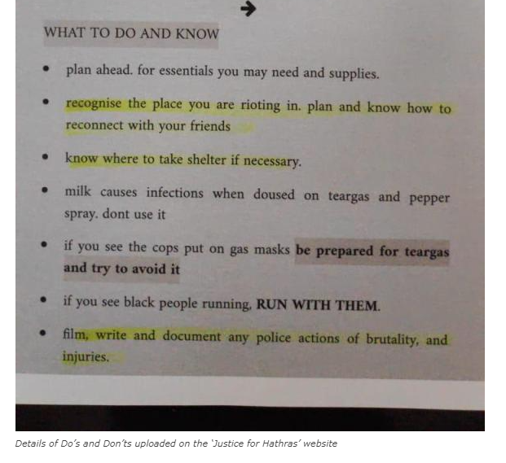
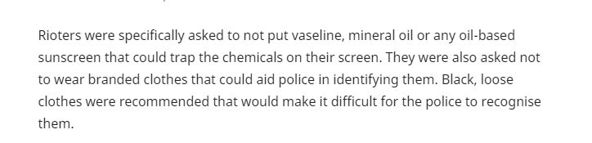
Could not find the word riot in the memento
The OpIndia article shares an image from https://justiceforhathrasvictim.carrd.co/
https://www.opindia.com/2020/10/justice-for-hathras-victim-carrd-website-pulled-down-instigate-violence-reports/
https://archive.is/5ZH7V
Harveen Kaur CS 795: Web Archiving Forensics (Fall 2020)

Slide 18
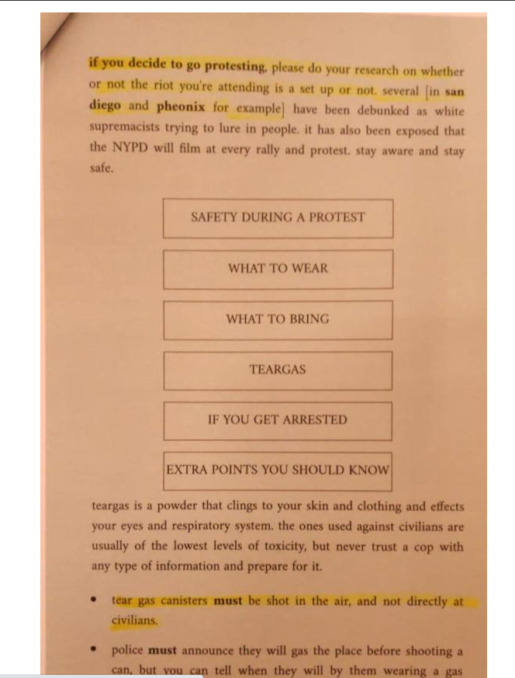
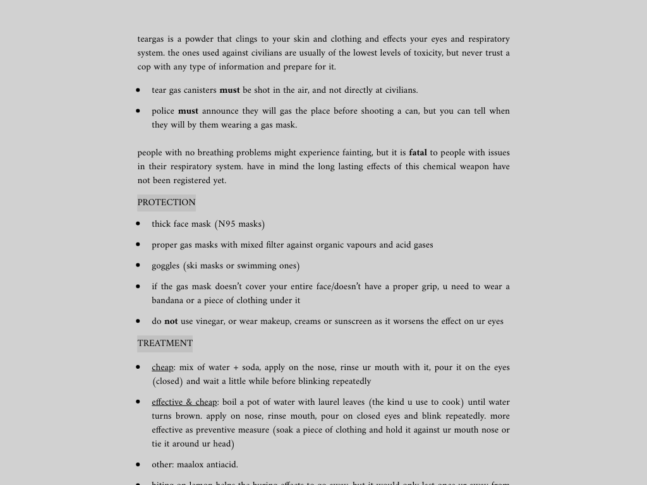
Image shared by the OpIndia article was not available in the memento
Not available in the memento
Memento of the website shows general protest rules, protection and treatment in case teargas is used
https://www.opindia.com/2020/10/justice-for-hathras-victim-carrd-website-pulled-down-instigate-violence-reports/
https://archive.is/5ZH7V
Harveen Kaur CS 795: Web Archiving Forensics (Fall 2020)

Slide 19
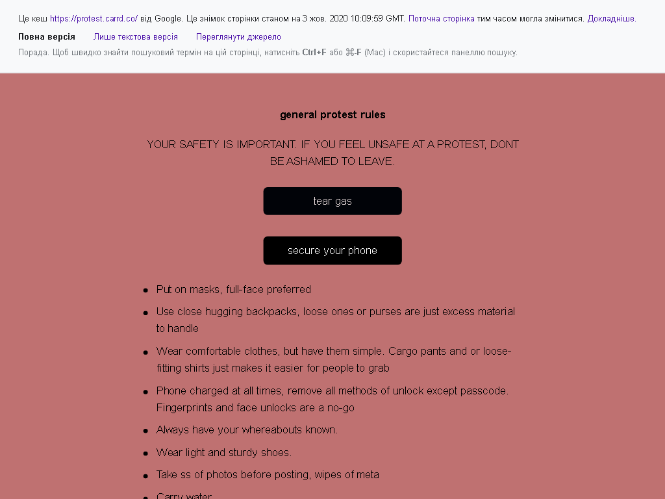

The justiceforhathrasvictim.carrd.co shared general protest rules
Asks people to leave if not comfortable with the protests
Shares links to protests, protest rules, safety guidelines and different petitions
https://www.opindia.com/2020/10/justice-for-hathras-victim-carrd-website-pulled-down-instigate-violence-reports/ https://archive.is/5ZH7V
Harveen Kaur CS 795: Web Archiving Forensics (Fall 2020)

Slide 20
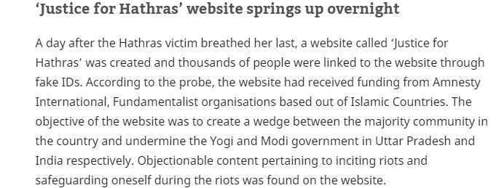
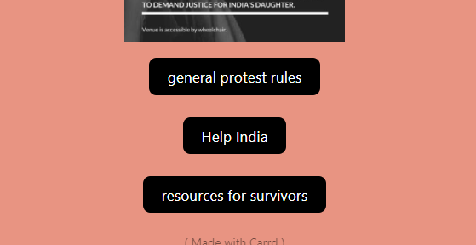
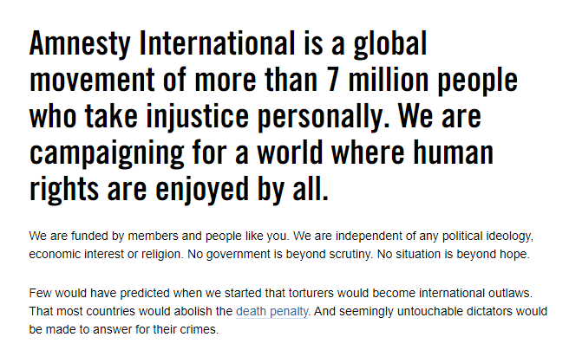
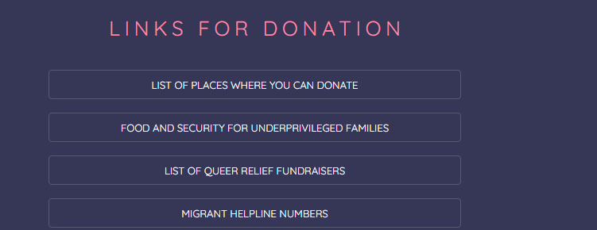
OpIndia article associates the Carrd website to Amnesty International
Links to Amnesty International India
The memento links to another Carrd
Based out of United Kingdom, claims to be independent of any religion.
https://web.archive.org/web/20201007042015/https://www.opindia.com/2020/10/justice-for-hathras-victim-carrd-website-pulled-down-instigate-violence-reports/
https://www.amnesty.org/en/
https://amnesty.org.in/support-indias-most-vulnerable-fight-covid-19-a-list-of-fundraisers-you-can-donate-to/
https://helpourindia.carrd.co/
http://archive.is/iAdP0
Harveen Kaur CS 795: Web Archiving Forensics (Fall 2020)

Slide 21
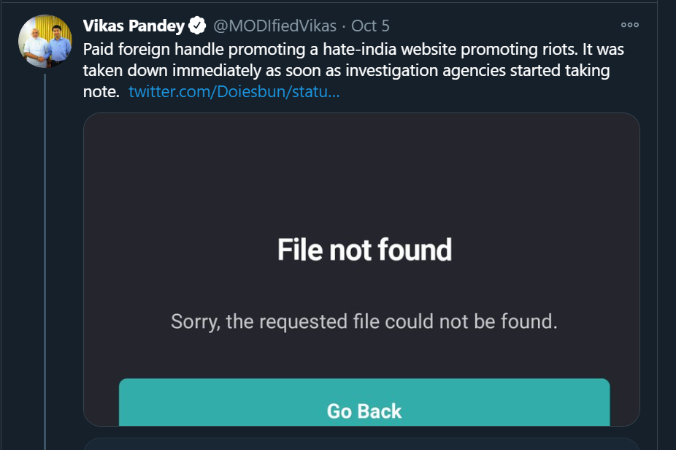
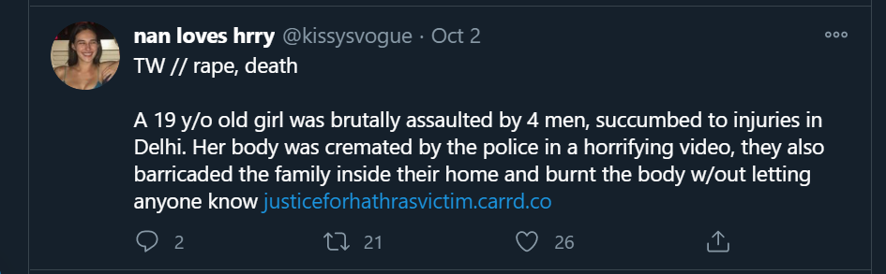
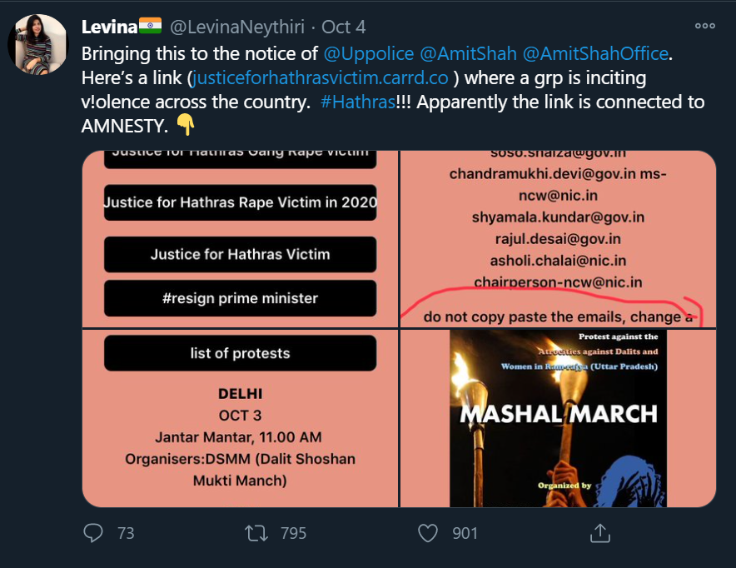
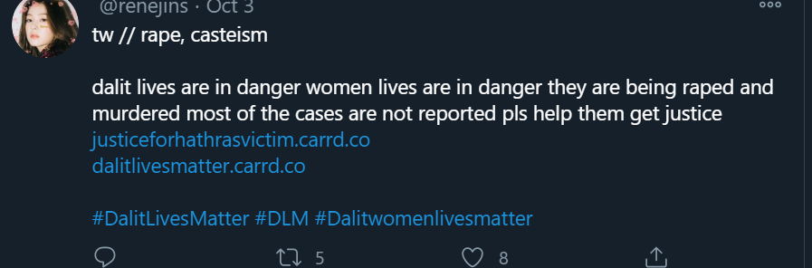
General public on Twitter was for and against the https://justiceforhathrasvictim.carrd.co/
Tweets in support of the Carrd
Tweets targeting the justiceforhathrasvictim.carrd.co/ website
https://twitter.com/search?q=justiceforhathrasvictim.carrd.co%2F&src=typed_query
Harveen Kaur CS 795: Web Archiving Forensics (Fall 2020)

Slide 22
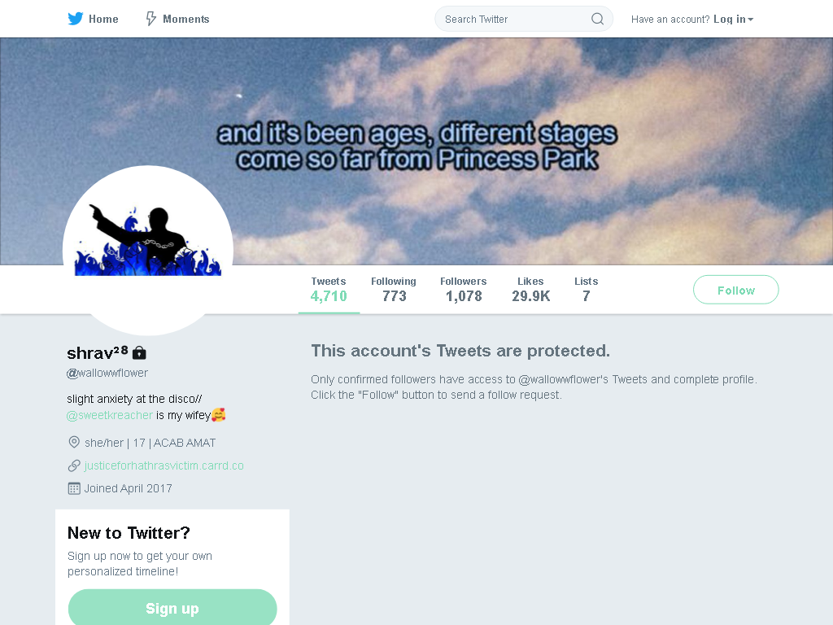
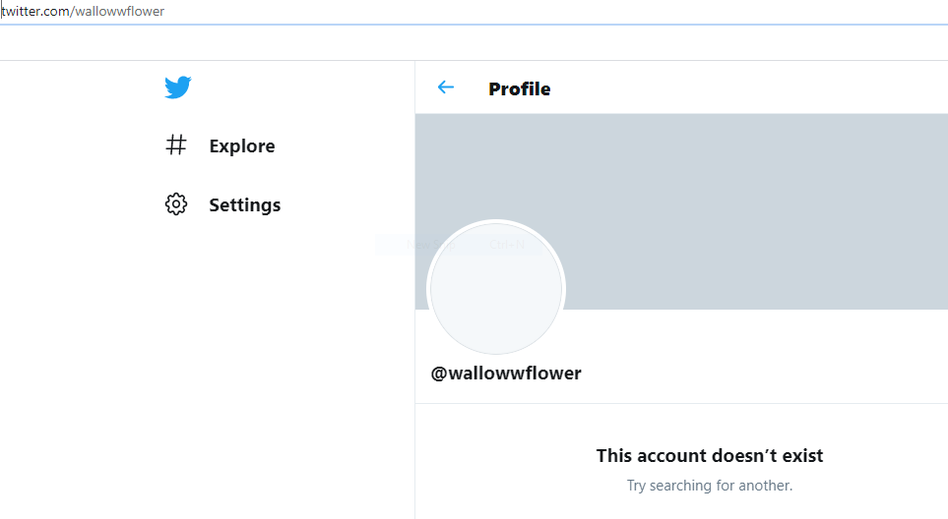
The alleged creator of the website deletes their Twitter account
Twitter account no longer exists
Twitter user claims to create the website
10-01-2020
The account’s tweet were protected according to the memento
10-05-2020
https://web.archive.org/web/20201007042015/https://www.opindia.com/2020/10/justice-for-hathras-victim-carrd-website-pulled-down-instigate-violence-reports/
http://archive.is/UvRxR https://web.archive.org/web/20201006172036/https://twitter.com/Vedic_Revival/status/1312987858614071296
https://twitter.com/wallowwflower
Harveen Kaur CS 795: Web Archiving Forensics (Fall 2020)

Slide 23
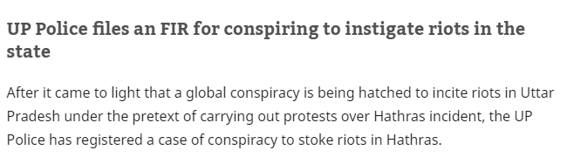
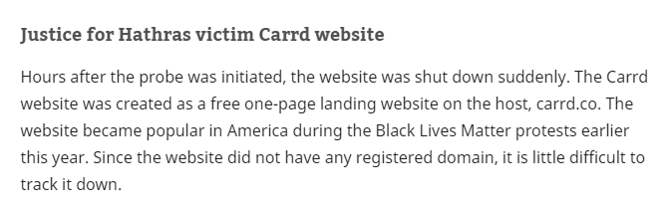
How was the website taken down?
Considers the website creation to be a global conspiracy
The OpIndia article does not mention that the website was taken down by the government, an FIR was lodged against an unidentified person, this could be the reason for the take down.
https://web.archive.org/web/20201007042015/https://www.opindia.com/2020/10/justice-for-hathras-victim-carrd-website-pulled-down-instigate-violence-reports/
Harveen Kaur CS 795: Web Archiving Forensics (Fall 2020)

Slide 24
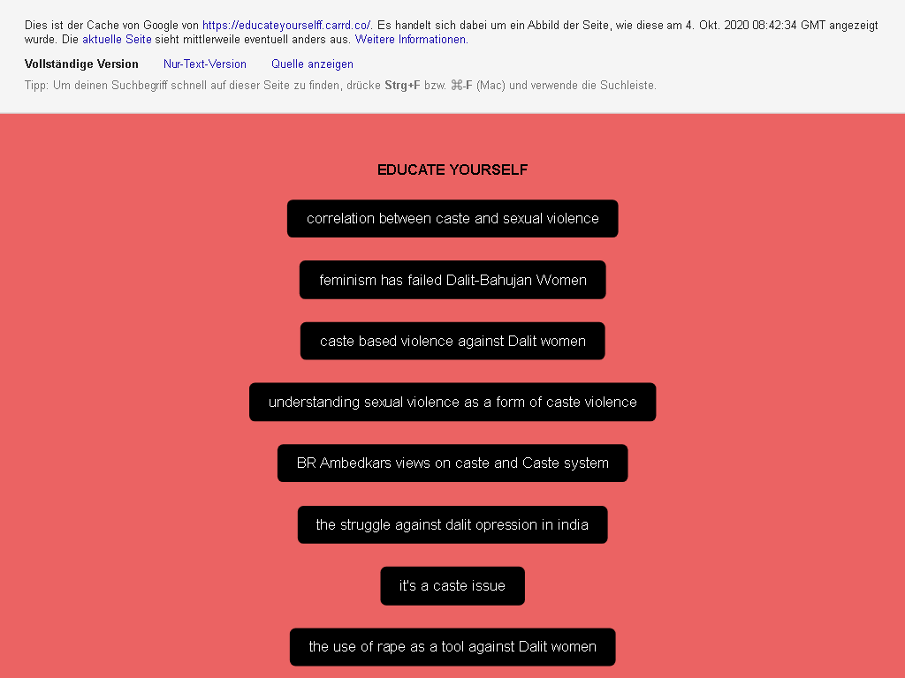
The https://justiceforhathrasvictim.carrd.co website links to another Carrd
https://educateyourselff.carrd.co/
This website doesn’t exist anymore
Website linked to different articles that discuss the issue of caste based violence
https://archive.is/Ufto2
Harveen Kaur CS 795: Web Archiving Forensics (Fall 2020)

Slide 25
Summary
The justiceforhathrasvictim.carrd.co/ had an estimated lifespan of 5 days.
The first memento was created after the website was taken down.
A memento was created of the Google cache of the website.
The website shared protest rules, posters, general protest instructions, petitions and articles about caste based violence in India
The OpIndia article probably fabricated evidence and had a political bias.
Tweets regarding the https://justiceforhathrasvictim.carrd.co/ were divided
Harveen Kaur CS 795: Web Archiving Forensics (Fall 2020)

